Slide 1
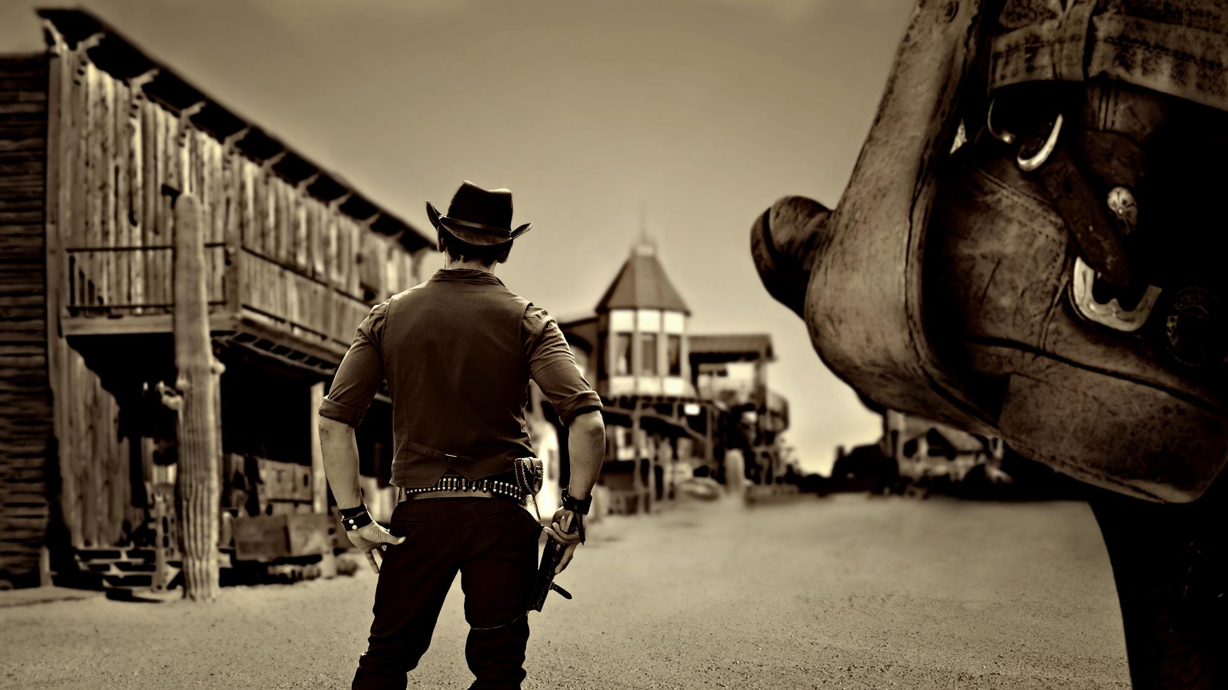

The Times They Are A Changing
THE GOOD THE BAD & THE UGLY
OF THE 2021 LEGISLATIVE SESSION
COLBY COASH & MATT BELKA

Slide 2

NEW FACES & TERM LIMITS
2021-22 SENATORS
D1 - Slama
D2 - Clements
D3 - Blood
D4 - Hilkemann
D5 - McDonnell
D6 - M. Cavanaugh
D7 - Vargas*
D8 - Hunt
D9 - J. Cavanaugh
D10 - DeBoer
D11 - McKinney
D12 - Lathrop
D13 - Wayne*
D14 - Arch
D15 - Walz
D16 - B. Hansen
D17 - Albrecht
D18 - Lindstrom
D19 - Flood (returning)
D20 - McCollister
D21 - Hilgers
D22 - Moser
D23 - Bostelman
D24 - Kolterman*
D25 - Geist
D26 - M. Hansen
D27 - Wishart
D28 - Pansing Brooks
D29 - Bostar
D30 - Dorn
D31 - Pahls (returning)
D32 - Brandt
D33 - Halloran
D34 - Friesen
D35 - Aguillar (returning)
D36 - Williams
D37 - Lowe
D38 - Murman*
D39 - Linehan
D40 - Gragert*
D41 - Briese*
D42 - Groene
D43 - Brewer
D44 - Hughes*
D45 - Sanders
D46 - Morfeld
D47 - Erdman*
D48 - Stinner*
D49 - Day

Slide 3
OLD FACES
2020 EDUCATION COMMITTEE
Sen. Mike Groene, Chairperson
Sen. Tom Brewer
Sen. Dave Murman
Sen. Rick Kolowski
Sen. Lou Ann Linehan
Sen. Adam Morfeld
Sen. Patty Pansing Brooks
Sen. Lynne Walz

Slide 4
NEW FACES
2021 EDUCATION COMMITTEE
Sen. Lynne Walz, Chairwoman
Sen. Jen Day
Sen. Lou Ann Linehan
Sen. Terrell McKinney
Sen. Adam Morfeld
Sen. Dave Murman
Sen. Patty Pansing Brooks
Sen. Rita Sanders

Slide 5
OLD FACES
2021 REVENUE COMMITTEE
Sen. Lou Ann Linehan, Chair
Sen. Tom Briese
Sen. Curt Friesen
Sen. Mike Groene
Sen. John McCollister
Sen. Sue Crawford
Sen. Brett Lindstrom
Sen. Mark Kolterman

Slide 6
NEW FACES
2021 REVENUE COMMITTEE
Sen. LouAnn Linenhan, Chair
Sen. Joni Albrecht
Sen. Eliot Bostar
Sen. Tom Briese
Sen. Mike Flood
Sen. Curt Friesen
Sen. Brett Lindstrom
Sen. Rich Pahls

Slide 7
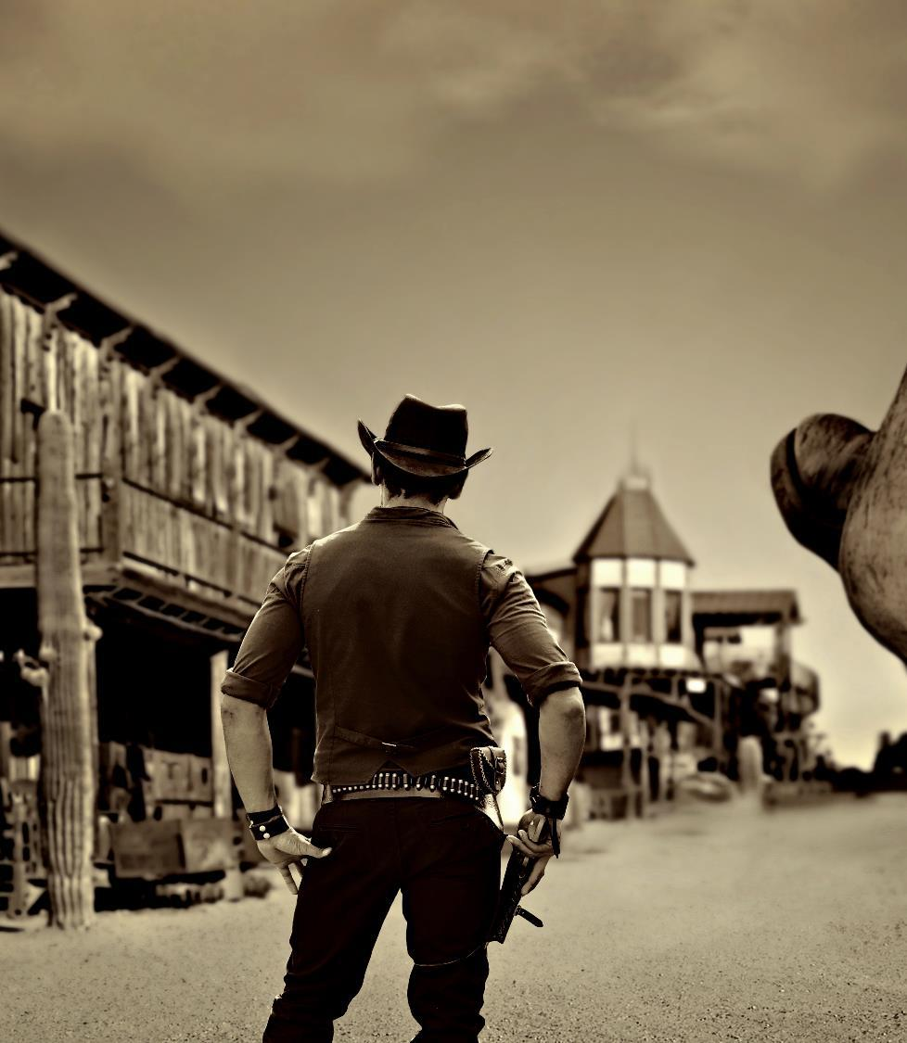
BY THE NUMBERS
684 total bills introduced
96 bills tracked by NASB (14%)

Slide 8
THEMES FROM THE
2021 SESSION
Spending Control
Liability
School Choice/Option Enrollment
Transparency
Student Discipline
Curriculum Mandates
Other

Slide 9
SCHOOL CHOICE/
OPTION ENROLLMENT
LB 364 (Linehan) - Adopt the Opportunity Scholarships Act and provide tax credits
Failed cloture (29 of 33 votes needed)
Senator Wayne will likely be taking the lead in pushing
the bill in 2022.
LB 550 (Wayne) - Change enrollment option limits and provisions for part-time enrollment in schools
Increased option enrollment options from 1 to 5.
LB 651 (Wayne) - Provide a termination date for the enrollment option program
Terminated option enrollment
Was not voted on

Slide 10
TRANSPARENCY
LB 644 (B. Hansen) - Adopt the Property Tax Request Act, change dates relating to tax levies, and change provisions relating to property tax refunds
Signed by Governor
Takes effect January 1, 2022
Amended with input from NASB
LB 83 (Flood) - Change public meeting provisions and provide for virtual conferencing under the Open Meetings Act
Signed by the Governor on April 21
Took effect on April, 22, 2021
LB 112 (Albrecht) - Require members of the public to be allowed to speak at each meeting subject to the Open Meetings Act-Government Committee

Slide 11
STUDENT DISCIPLINE (1)
LB 529 (Walz) - Change provisions for the distribution of lottery funds used for education, transfer powers and duties, create new acts and funds, and change education provisions
Would have allocated $$ for behavioral intervention training for educators through the ESUs.
Amended to include physical intervention provisions/authorization by educators
Failed cloture (28 of 33 votes needed)
3 year extension of lottery funds incorporated into LB 528 (through 23-24 school year)

Slide 12
STUDENT DISCIPLINE (2)
LB 154 (Wayne) - Require tracking of student discipline as prescribed
Signed by Governor on May 5
Beginning with the 2022-23 school year, individual student discipline data shall be reported to NDE and used as an indicator in AQuESTT
LB 198 (Vargas) - Change provisions relating to the Student Discipline Act
On General File

Slide 13
CURRICULUM/SCHOOL MANDATES
LB 452 (McKinney) - Adopt the Financial Literacy Act and provide graduation requirements and academic content standards
Signed by Governor
Amended with input by NASB & others
LB 281 (Albrecht) - Require child sexual abuse prevention programs for school students and staff
Placed on Select File March 24
Held over until 2022
LB 639 (Day) - Adopt the Seizure Safe Schools Act
Signed by Governor

Slide 14
NEXT SESSION
CHALLENGES, TONE & MOOD
LB 364 (Linehan) - Adopt the Opportunity Scholarships Act and provide tax credits.
Sen. Wayne will be taking the lead on this bill in 2022
Eliminate option enrollment
Was not voted on this session. (Introducer ill)
Unwillingness to engage the education community
  LB 132 failed … LR 141 in its place
    Committee makeup: Senators Bostar, Brandt, DeBoer, Dorn, Flood, Friesen, Groene, McKinney, Pahls, Wishart & Walz

Slide 15
NEXT SESSION
CHALLENGES, TONE & MOOD
Legislative Response to..
  School Finance
  Critical Race Theory
  NDE Health Standards
  Role, Scope, & Governance of NDE
  Mandating school year start/end date

Slide 16
Quotes & Votes
Eliminating TEEOSA got 21 votes
Aguilar, Albrecht, Bostelman, Brandt, Brewer, Dorn, Erdman, Geist, Halloran, Hansen, B., Hughes, Kolterman, Lindstrom, Linehan, Lowe, McDonnell, McKinney, Murman, Pahls, Slama, Wayne
“This indicates that work is needed on state aid to
local schools. It's time to roll up our sleeves.”
Sen. Bostelman
… more

Slide 17
Quotes & Votes
Comments on the Floor this Session …
“Nebraska children should have access to a high-quality education not by chance, not by privilege, but by right. Many of the children I represent are still getting Jim Crow math and back of the bus science. We shouldn't criticize parents for wanting something better. Choice is about the privilege of having the dollars to make that choice."
Sen. Wayne, who was previously against LB364 but changed his thinking
“Like Sen. Wayne, I used to be an opponent to Opportunity Scholarships. But with students in my district sometimes on buses for 3 hours a day, scholarships could help students find new school. Support for public schools is waning because of the sex education standards. As a Native American, I’m naturally skeptical of public education. Students and families should be able to pick schools that line up with their family values, are more cost effective for them, and will have better educational outcomes.”
Sen. Brewer, also hinting at being "programmed" at a white school

Slide 18
Quotes & Votes
Comments on the Floor this Session …
“The lines drawn in the sand are going to be very, very hard to overcome.”
Sen. Linehan, pointing to refusal of some schools to accept any changes in financing system.
“I didn't expect the tension between large public schools, small public schools, and private schools that he witnessed this year.”
Sen. Flood

Slide 19
Quotes & Votes
Comments on the Floor this Session …
Sen. Groene says opponents to these bills are "The Education Establishment" -- administrators, school districts and unions -- who stand "to profit, and profit is the right word, from more school funding."
Sen. Vargas acknowledges there's a lot of work to be done, but says he's committed to improving the public school system.

Slide 20
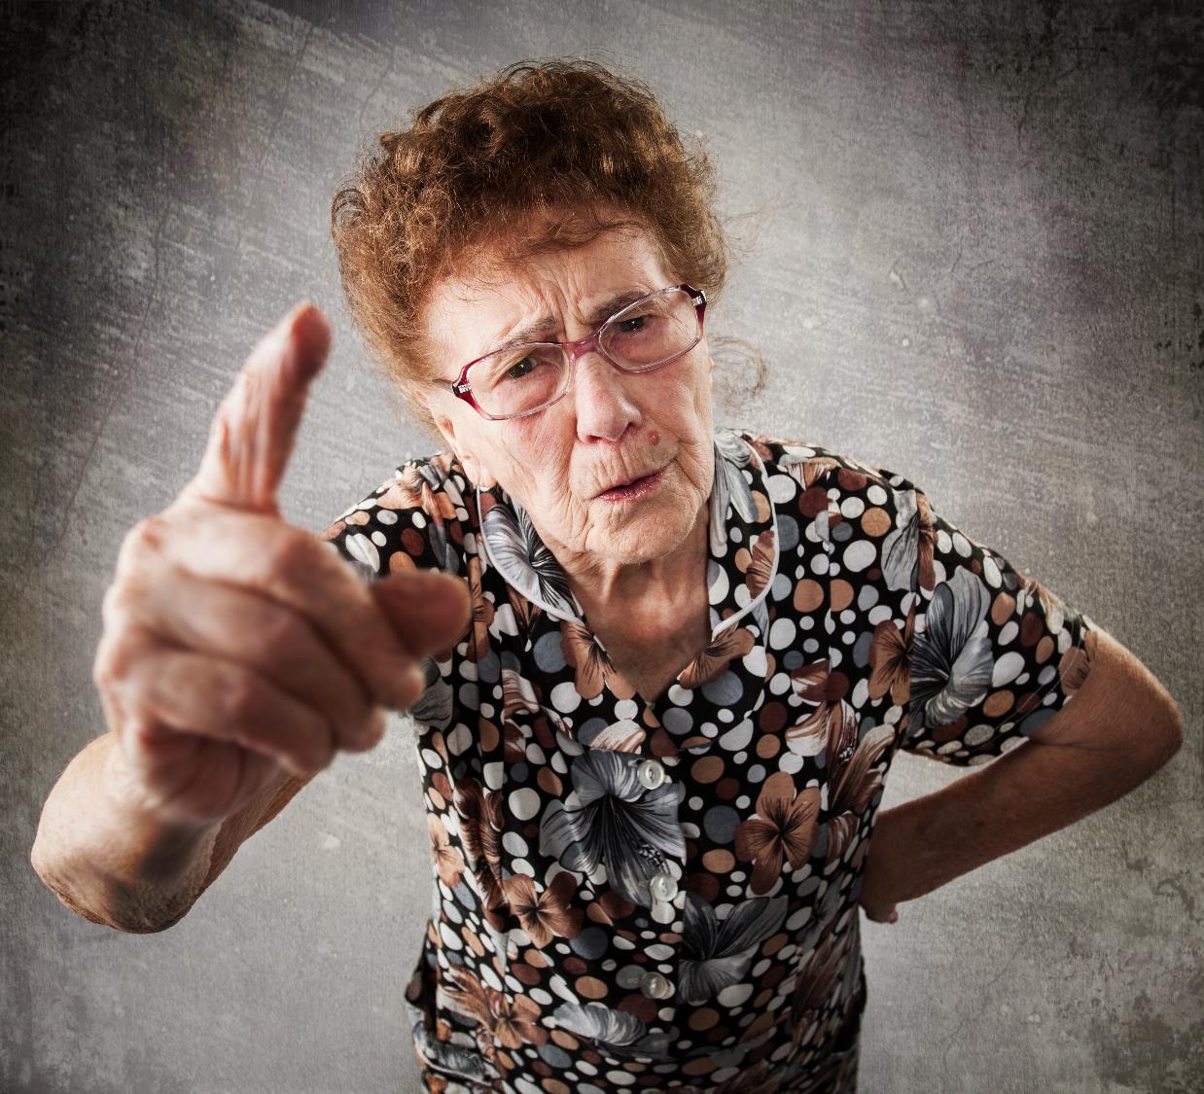

TELL YOUR STORY
(so someone else doesn’t)
Advocacy is Story Telling
There is a narrative being told about you, your motives, and your actions.
Who is sharing YOUR narrative?
What are THEY saying about you?

Slide 21

HOW WILL YOU ENGAGE?
ASK YOURSELF … WHAT IS MY ROLE?
You are an advocate for Public Education!
Be a resource. Stay informed.
Communicate TO and FOR your district.
No one is more qualified to talk about your district than YOU!

Slide 22

HOW WILL YOU ENGAGE?
DATA!

Slide 23
KNOW YOUR DATA!
Understand the data that will make a difference!
Arm yourself to be a
better storyteller!
Know where you’re at …
Where the Legislature is going …
AND HOW TO ALIGN!

Slide 24
KNOW YOUR DATA!
# of Kids in Free/Reduced Lunch
School Lands Per Pupil Reimbursement
Census vs Enrollment
# Languages Spoken in your District
# of ELL Students

Slide 25
KNOW YOUR DATA!
Average Class Size
# of Option Kids
% of Administrative Costs
What initiatives have you funded?
How are you engaged with the community?
What else?

Slide 26
THANK YOU!!!

